Slide 1

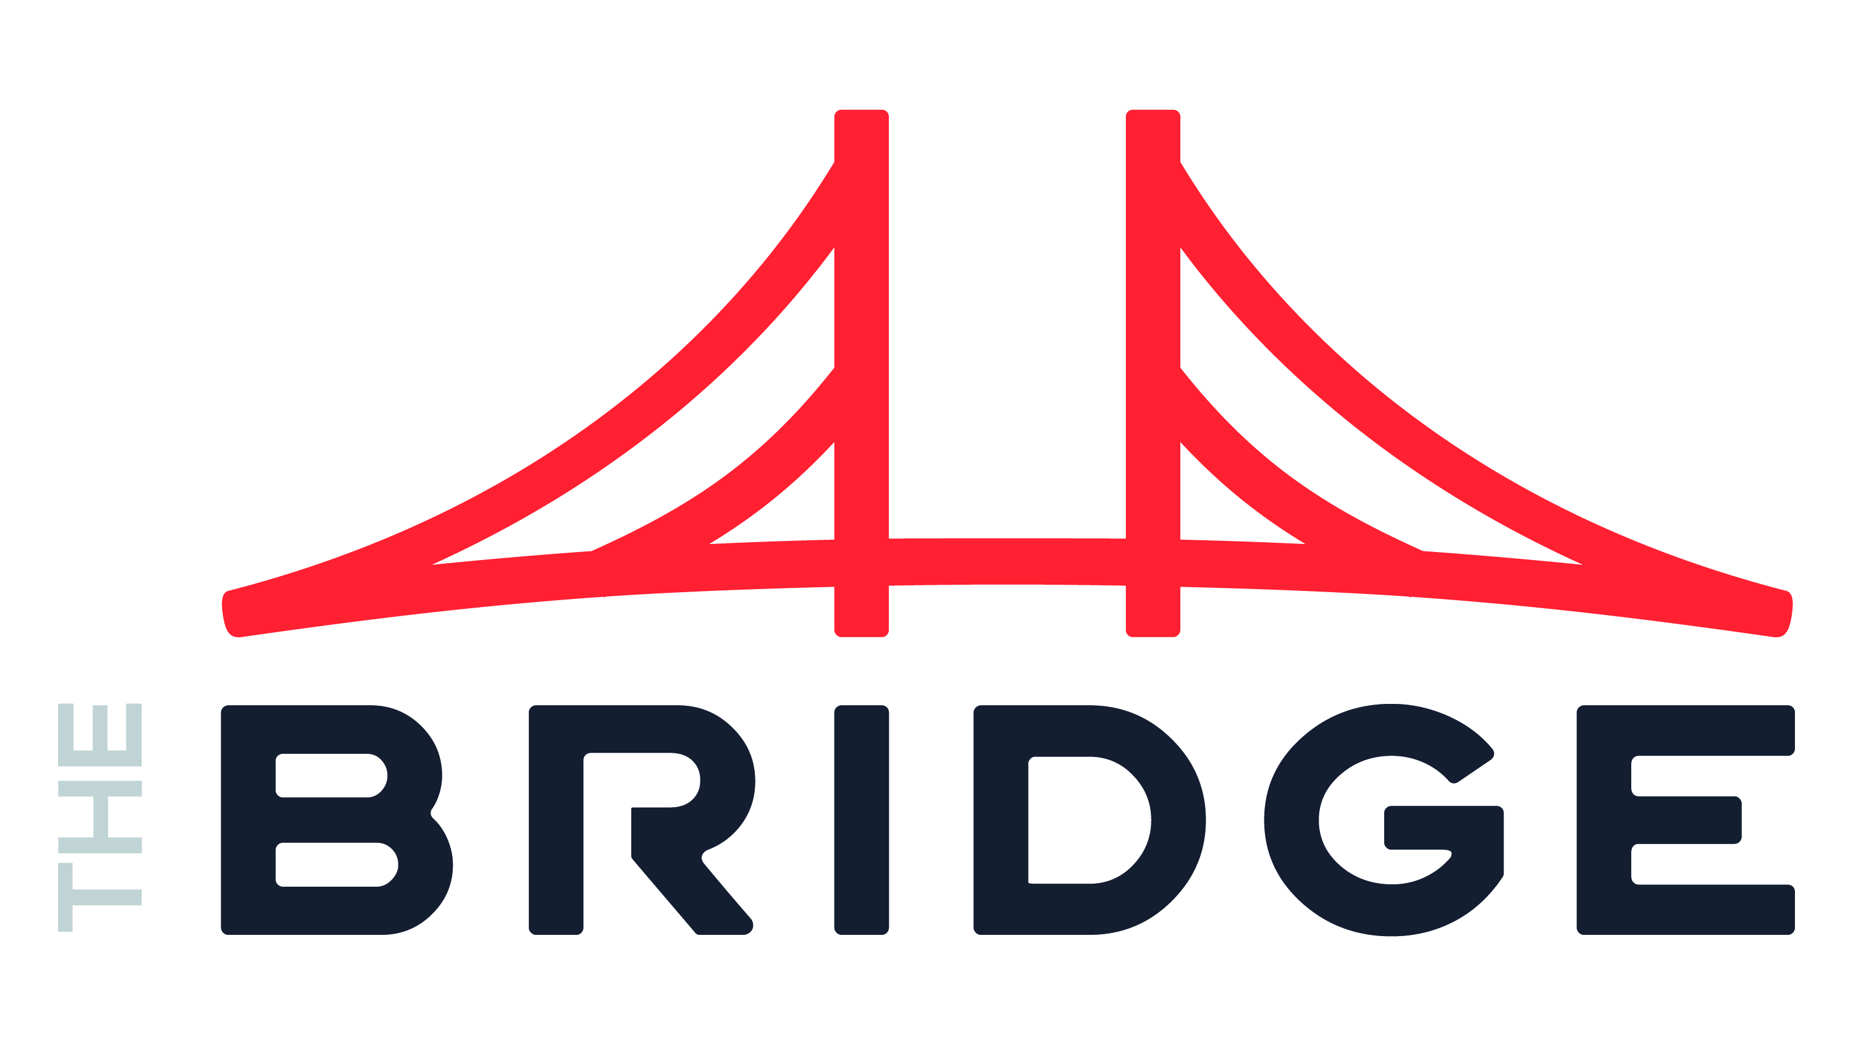
Matt Hubble Data & AI
INDUSTRIES
Industry Experience
Construction Materials | Financial Services | Hospitality | Software Development
EXPERIENCE
Data Integration Platform | Software Development
Problem: Client ended up without a subject matter expert for existing custom data integration processes due to an unexpected personnel gap and little documentation
Value: Matt analyzed the custom processes, identified and implemented improvements leading to higher reliability, better telemetry, and much quicker turn-around for new feature and failure resolution.
Tools: Python, AWS
Role: Functioned as a one-man team handling all aspects of integration development and support
Enterprise Analytics Platform | Hospitality
Problem: Client had over twenty sources of guest behavioral data and needed a better way to provide analytics
Value: Matt helped design and implement an enterprise-scale data warehouse and processing platform to provide a unified view of near-real-time guest data from disparate sources, allowing for deeper analytics and quicker decision making
Tools: SQL Server, Azure Data Factory, SSIS, Master Data Services, Qlik Replication
Role: Functioned as technical lead for infrastructure, data design, and performance optimization
BACKGROUND
Functional Skills
Data Architecture | Data Engineering | ETL Architecture |
Qualifications:
Matt is a proven data architect and engineer with experience in implementing both cloud and on-premises data platforms. His technical expertise includes designing the infrastructure aspects for these platforms as well as handling development and performance tuning.
BIO & CONTACT INFO
Email
Matt.Hubble@thebridge.com
Location
Bellingham, Washington
Matt has over 13 years experience in Data and has worn many hats over that time. During his stint as a Database Administrator, he was frequently told he’s “not like every other DBA” since he doesn’t just say “no.” After work, you’ll find him on a mountain bike.

